Slide 1
Data engineering 1 Term project 2
Team Manila:
Muhammad Talha Zahid
Haaris Cheema
Sabina Umarova
Peter Endes-Nagy

Slide 2
Executive summary
Analysis question:
Association pattern between GDP per capita, unemployment rates, population and suicide rates
Collection of data from two sources:
1) World Health Organisation
2) World Development Indicators
Utilization of 3 methods:
1. MySQL
2. R
2. API in Knime
Results:

Slide 3
World Bank API – URL Breakdown
version of the indicators API
Indicators
(GDP, unemployment, population)
scheme
format (JSON)
http://api.worldbank.org/v2/country/all/indicator/NY.GDP.PCAP.CD;SL.UEM.TOTL.ZS;SP.POP.TOTL?source=2&format=json&date=2010:2019
domain
countries (all)
dataset source
date range

Slide 4
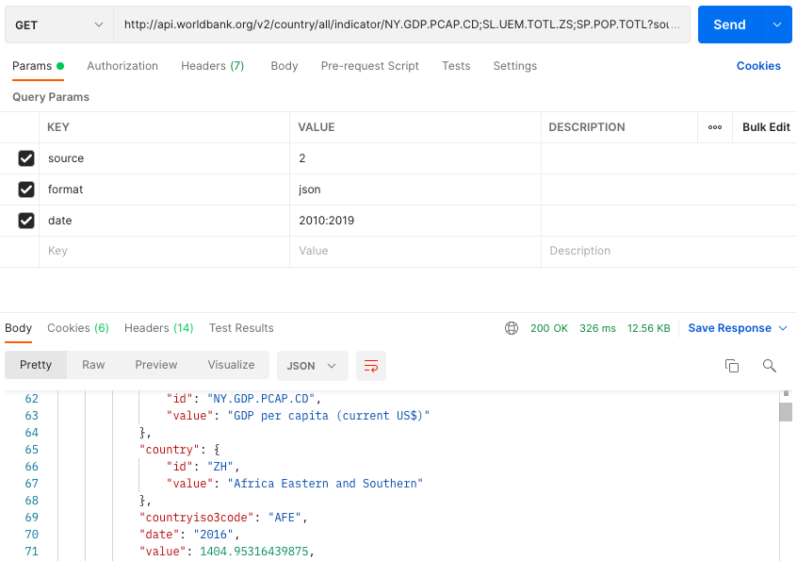
World Bank API – Postman result

Slide 5
MySQL – Suicides data
Download suicides data from World Health Organisation
Transformed data into .SQL format with Freeware software
Created table Suicides
Dropped unnecessary columns
Export data into Knime using MySQL connector node

Slide 6
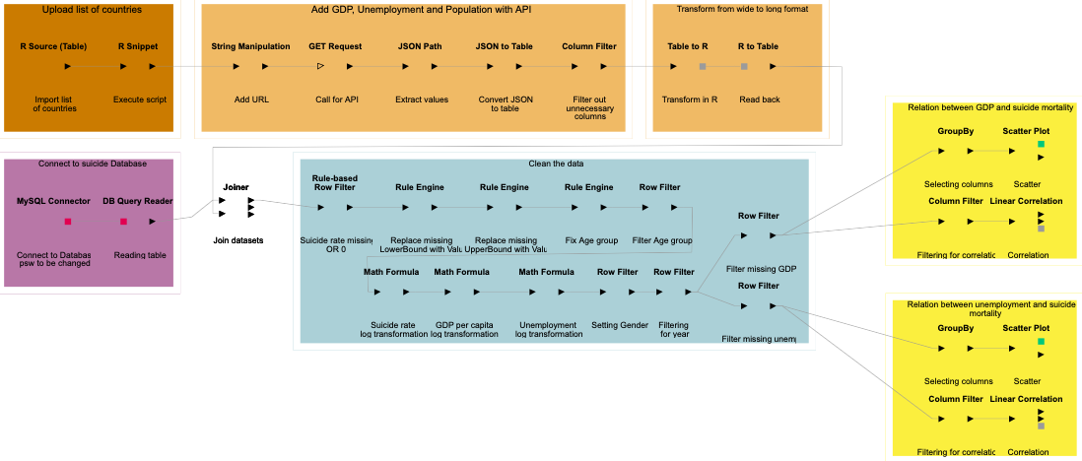
Knime Workflow

Slide 7
Analytics

